Slide 1
Schemas: learning and use in Humans and RNNs
Andre Beukers

Slide 2
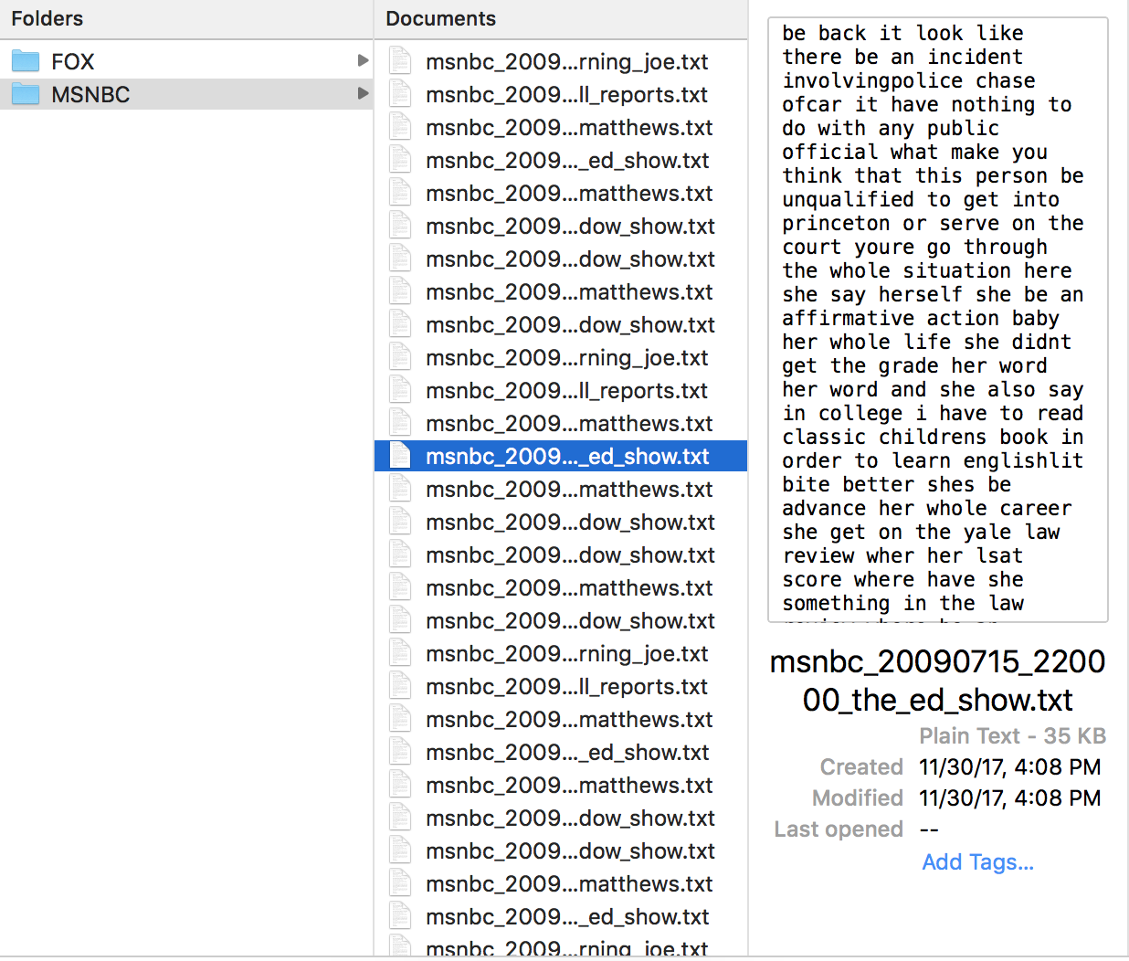
dataset
100M words from FOXNEWs transcripts
100M words from MSNBC transcripts
2 way train test split
TRAIN
TEST
MSN
FOX

Slide 3
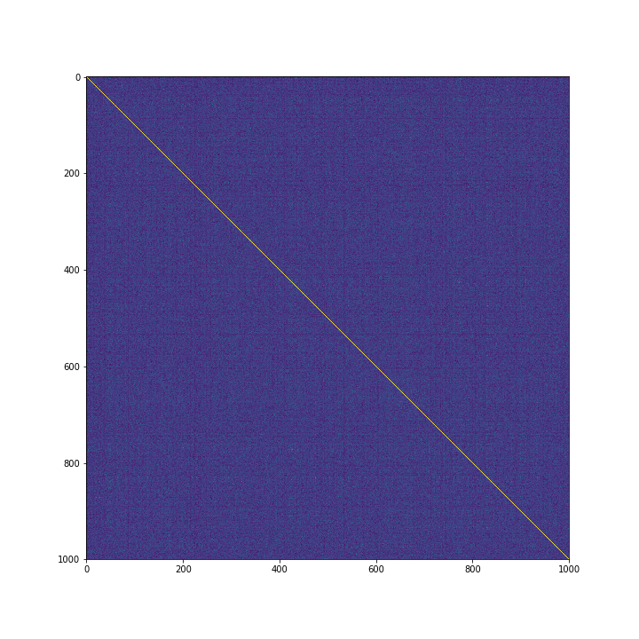
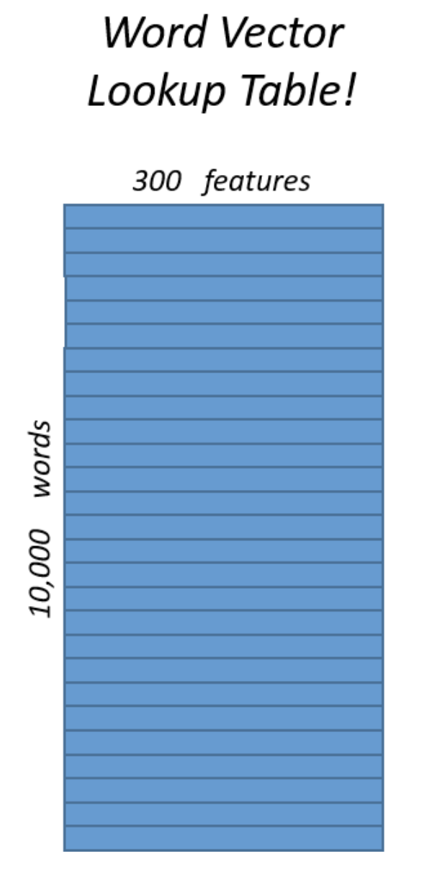
similarity analyses
word by word similarity matrix
TRAIN
TEST
MSN
FOX

Slide 4
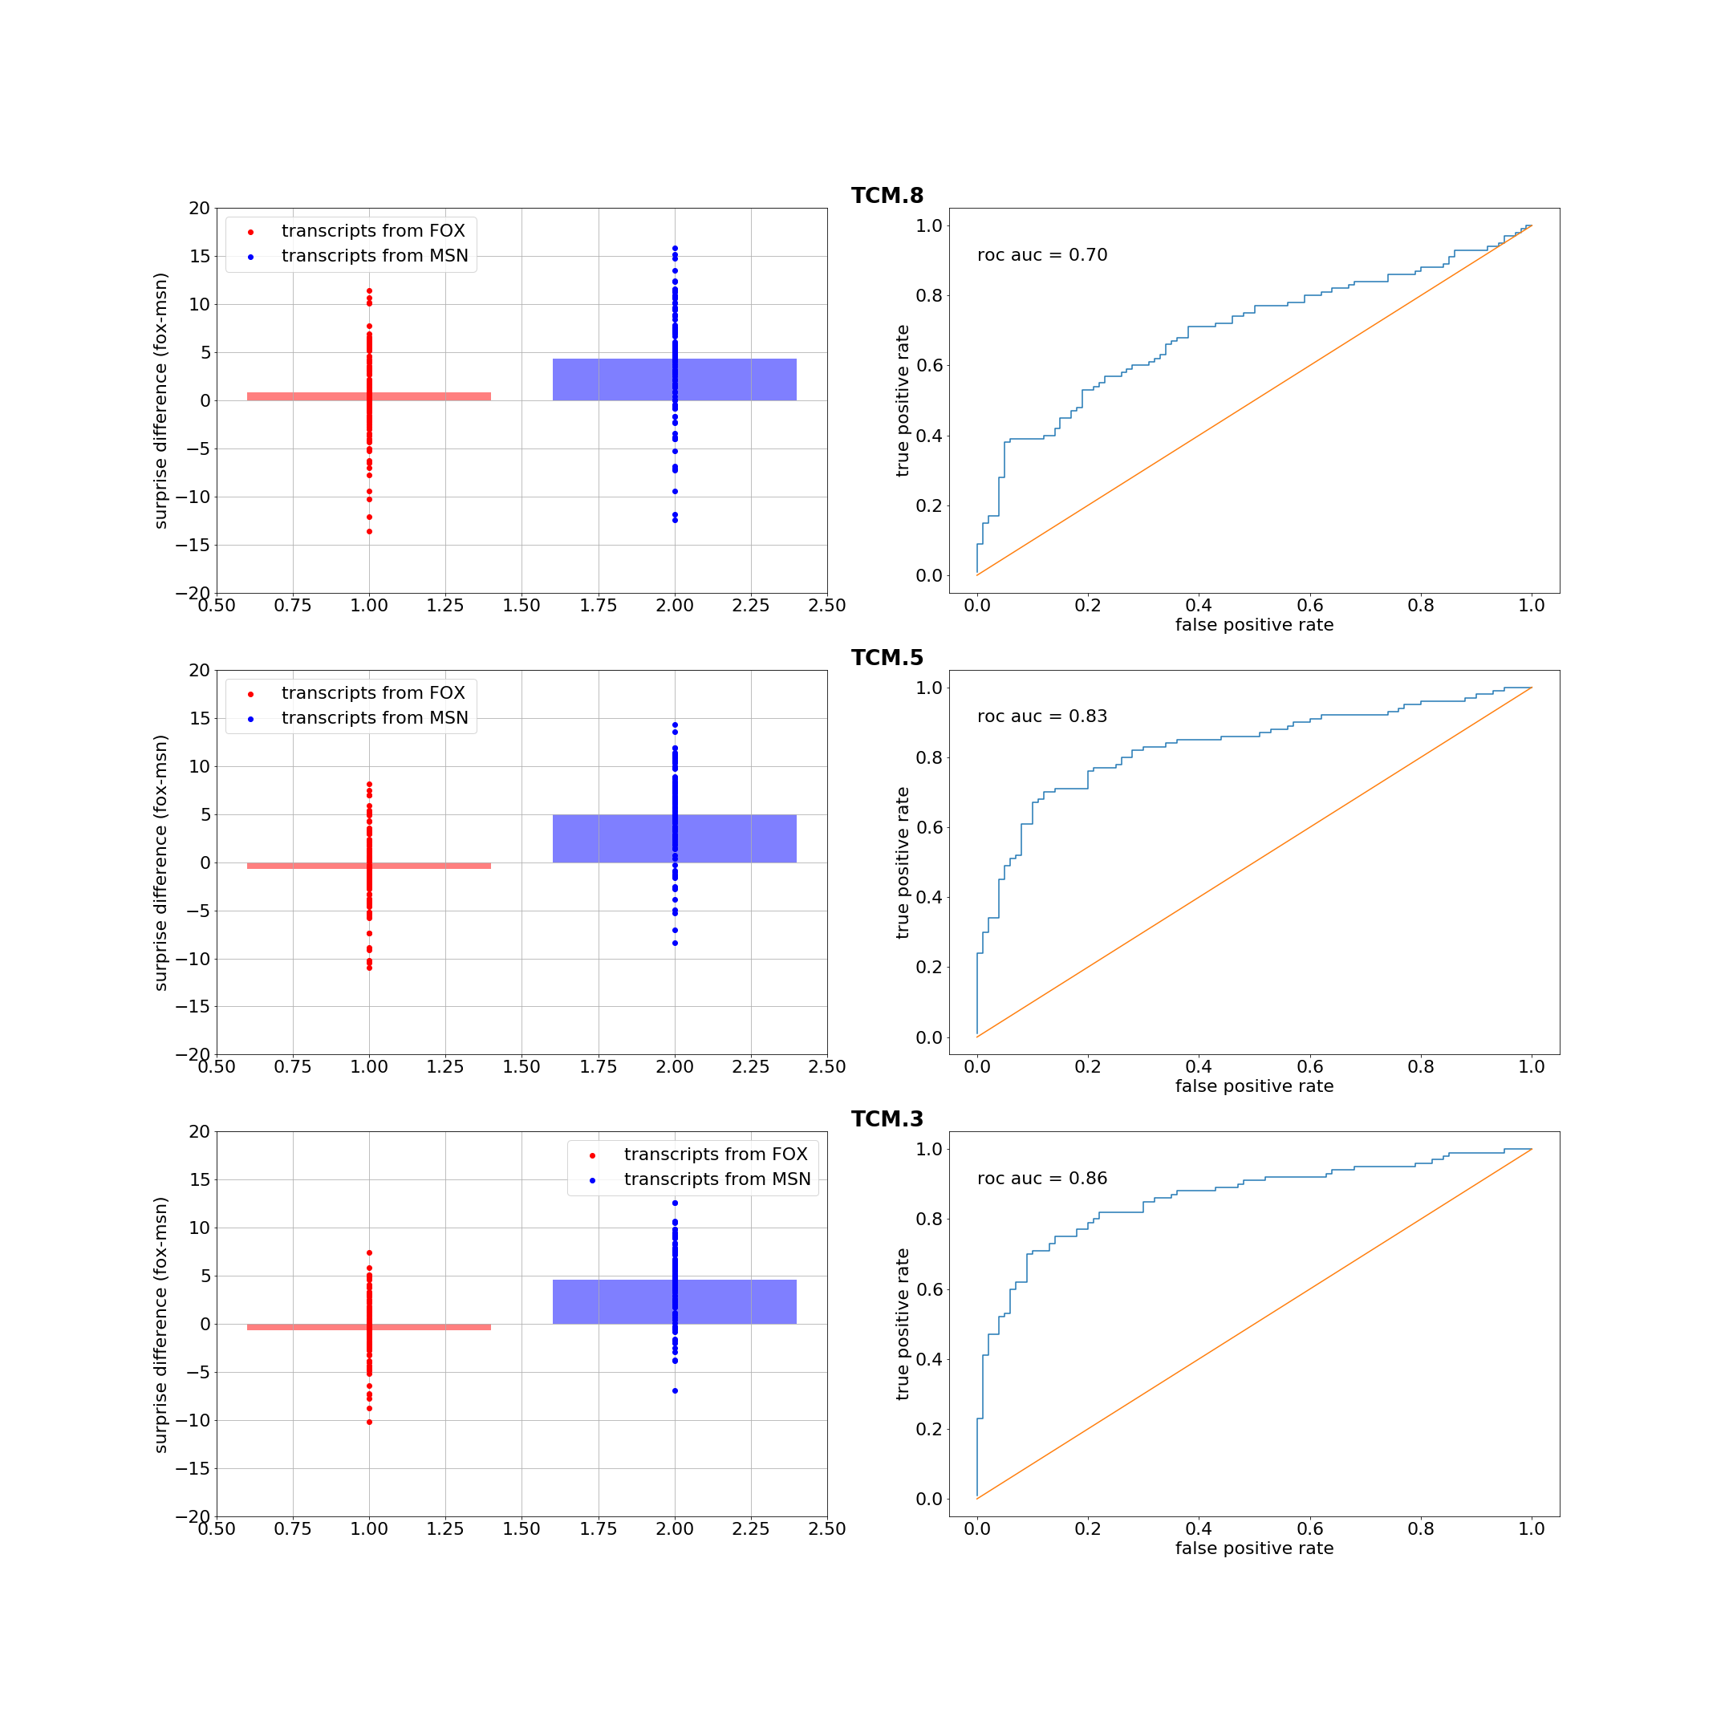

Slide 5
Schemas: learning and use in Humans and RNNs
Andre Beukers

Slide 6
Schemas
Other similar knowledge structures:
Narratives and gist
Concepts and categories
Statistical regularities
Gilboa & Marlatte, 17

Slide 7
Schemas
other similar knowledge structures:
narratives and gist
concepts and categories
statistical regularities
tasks:
paired associates (Tse, et al., 07) – prediction, association
AB-AC paradigm (Schlichting et al., 16; Presto et al., 15) – inference
first half of a movie (van Kesteren, 2010, 2012)
Gilboa & Marlatte, 17

Slide 8
Schemas
a scaffolding for memory
how are they learned and used?
constructed from multiple episodes
supports encoding
affords prediction
affords generalization
Notes:
add prediction

Slide 9
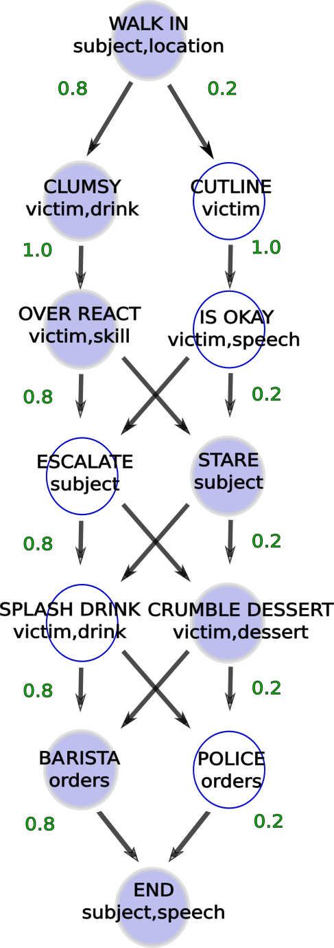
Coffee shop world
sample fillers:
subject = [Alice, Bob]
victim = [Bill, Claire]

Slide 10
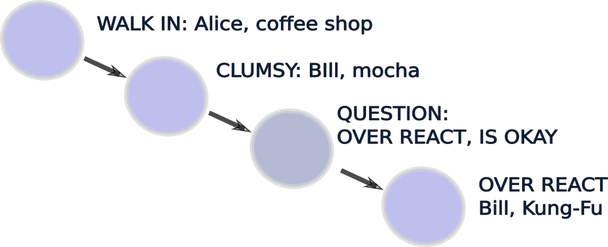
Coffee shop world
sample fillers:
subject = [Alice, Bob]
victim = [Bill, Claire]

Slide 11

Coffee shop world
sample fillers:
subject = [Alice, Bob]
victim = [Bill, Claire]

Slide 12
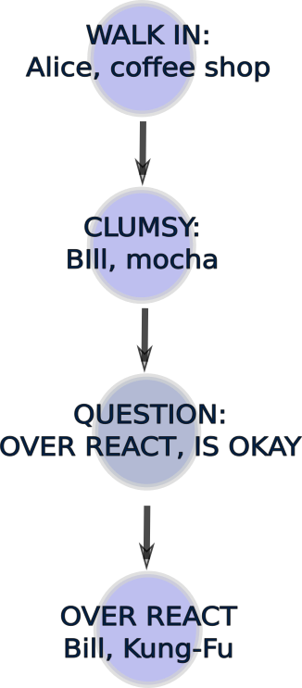
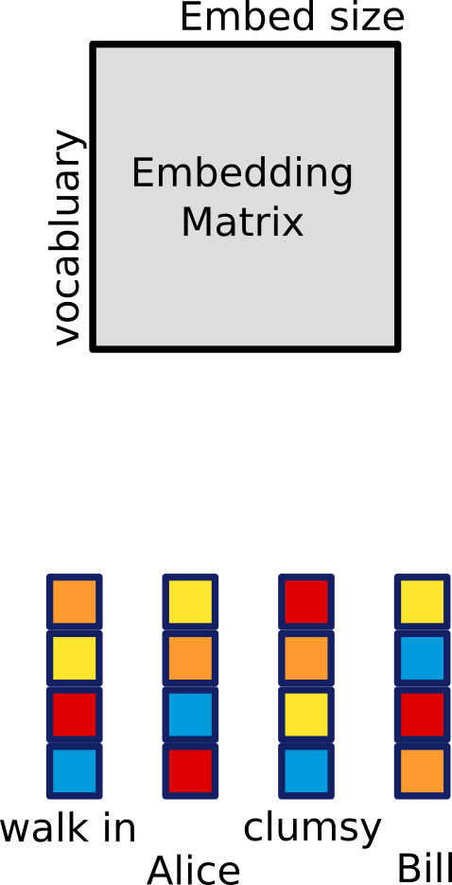
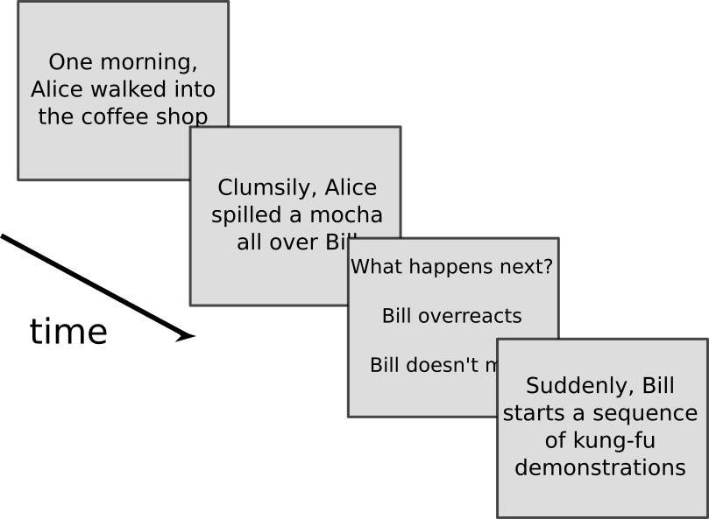
humans
nets

Slide 13
100 stories
probability of question 60%
different stories sequences
2 subjects 2 victims

Slide 14
One morning Alice walked into the coffee shop

Slide 15
Clumsily, Alice spilled a coffee over Bill

Slide 16
What happens next?
Bill really does not mind, he just returned from yoga and is at peace
Suddenly, Bill starts a sequence of Kung-fu moves

Slide 17
Suddenly, Bill starts a sequence of kung-fu moves

Slide 18
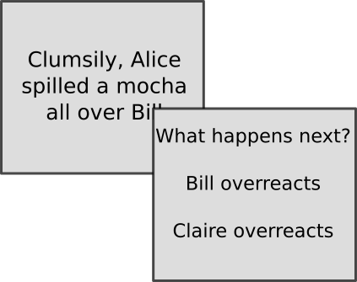
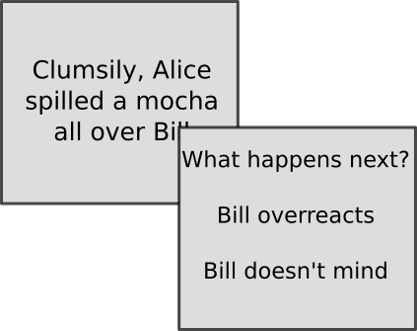
two types of questions
filler
transition

Slide 19
correct or incorrect
sliding window proportion of correct trials

Slide 20
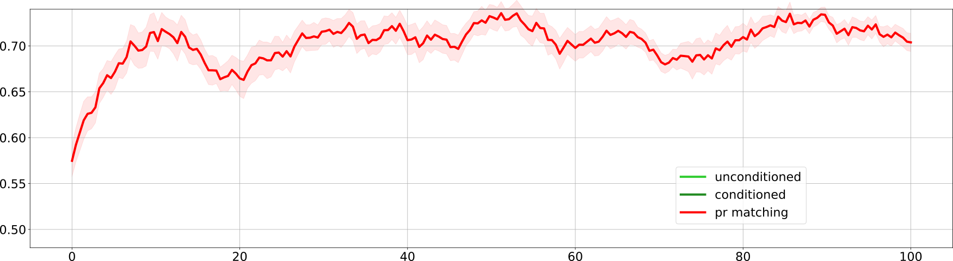
probability matching

Slide 21
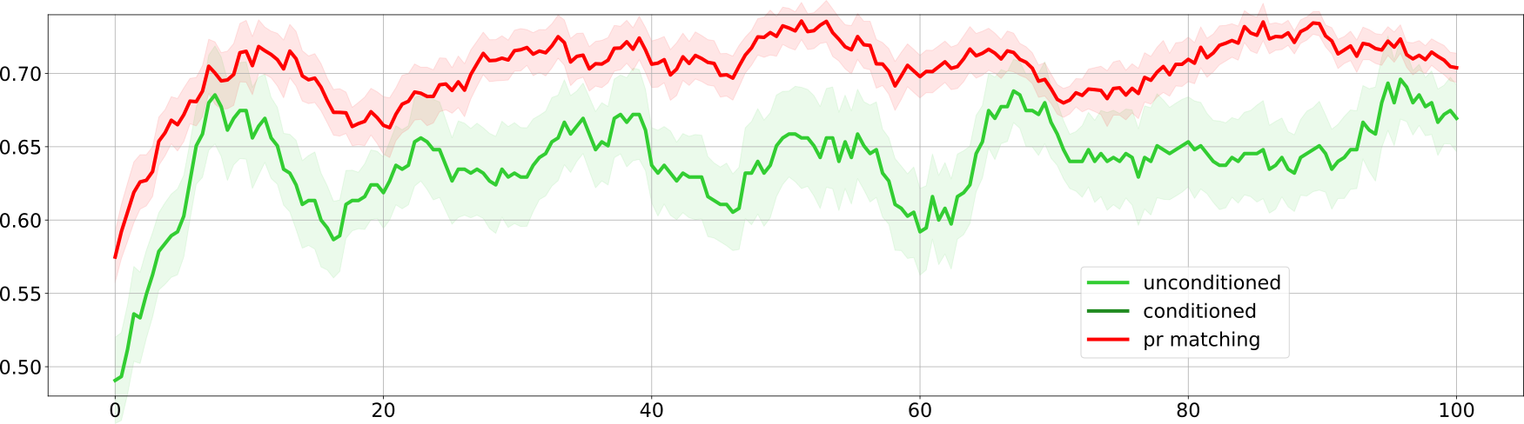
unconditioned

Slide 22
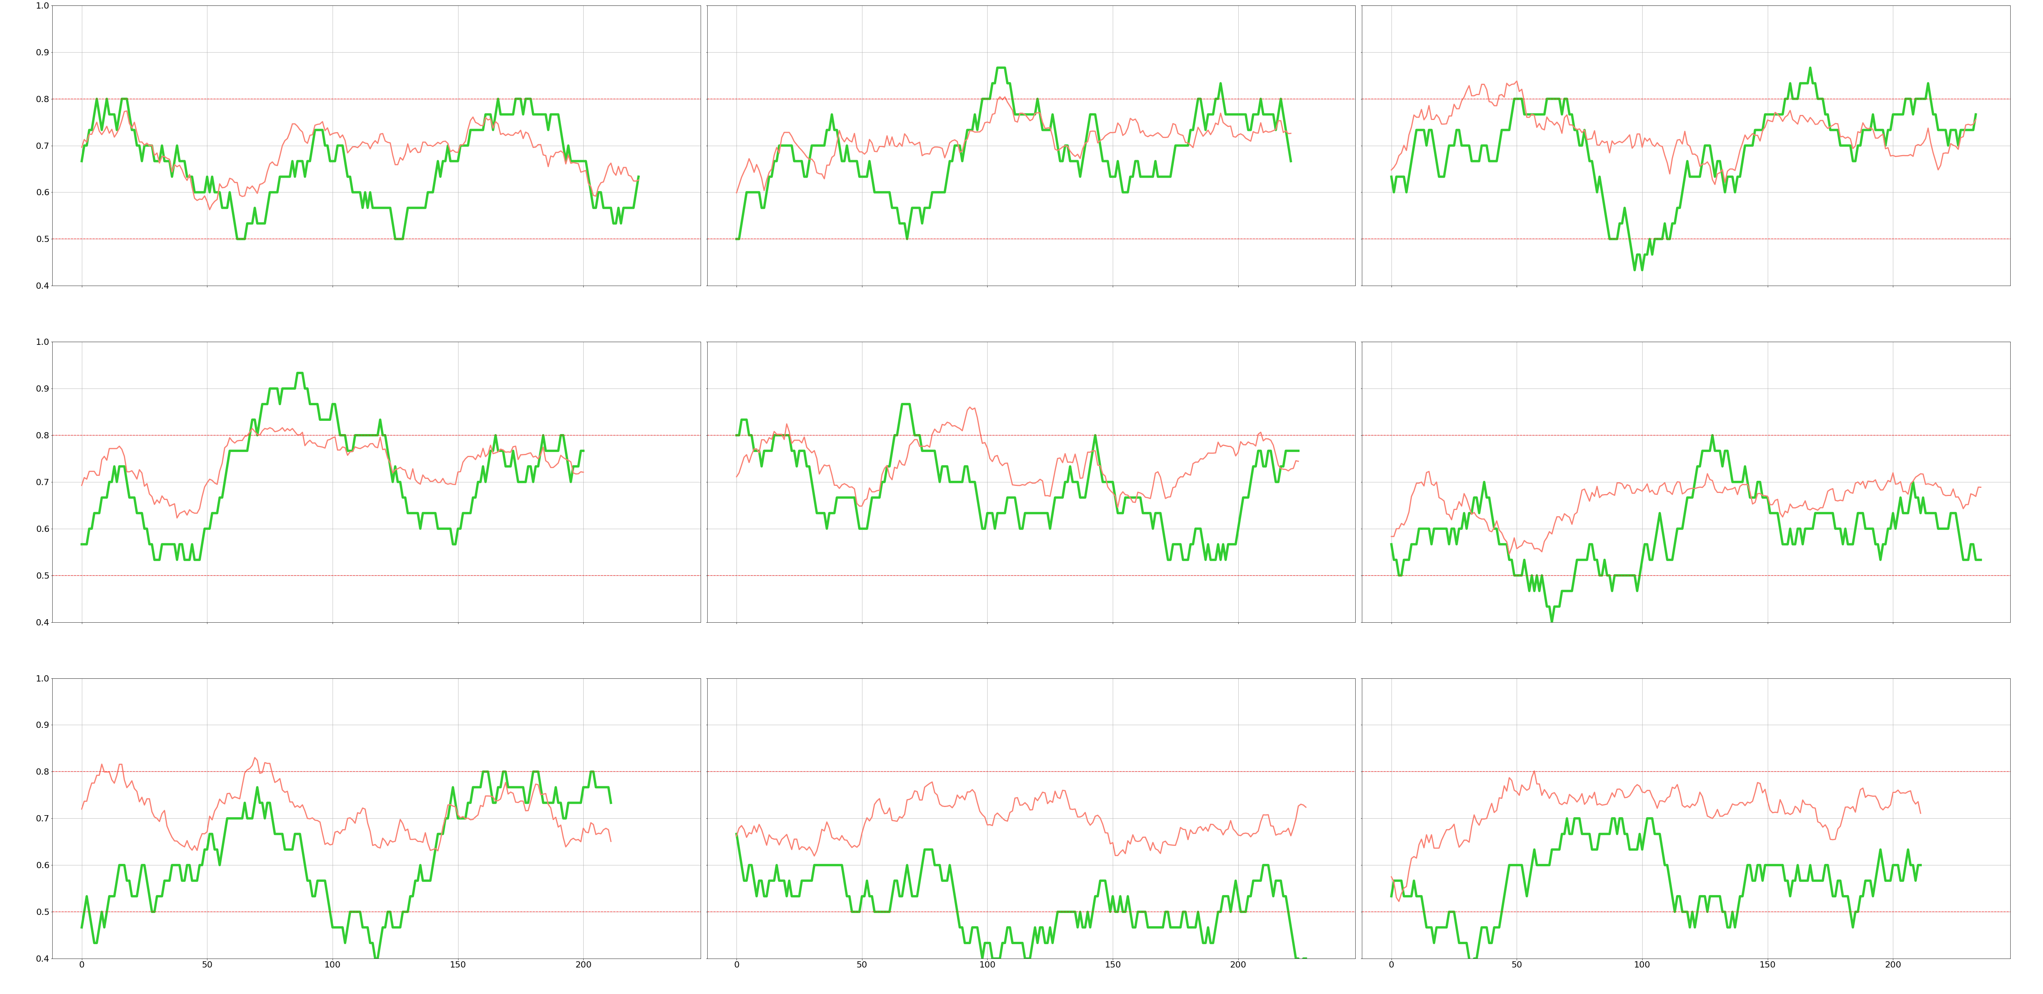
unconditioned, subjects

Slide 23
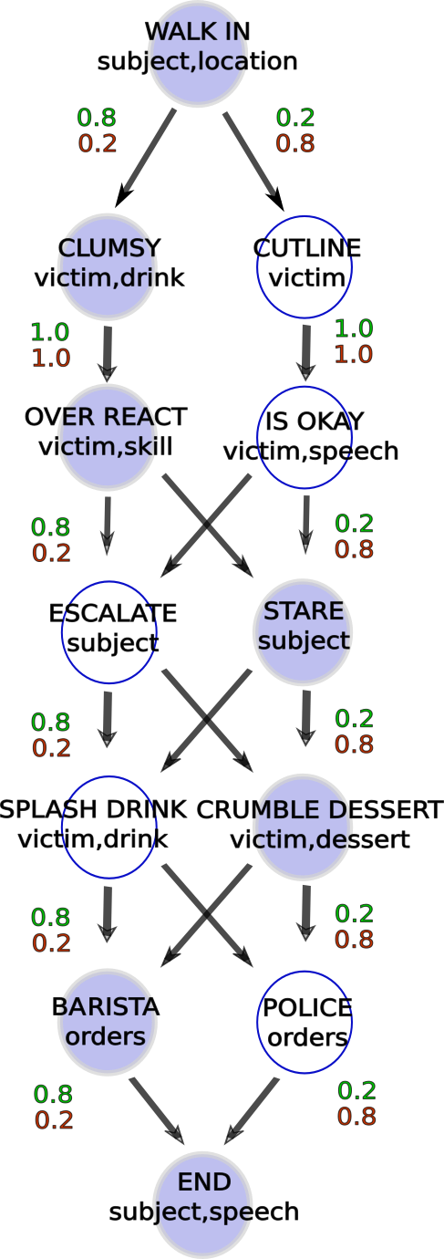
unconditioned versus conditioned

Slide 24
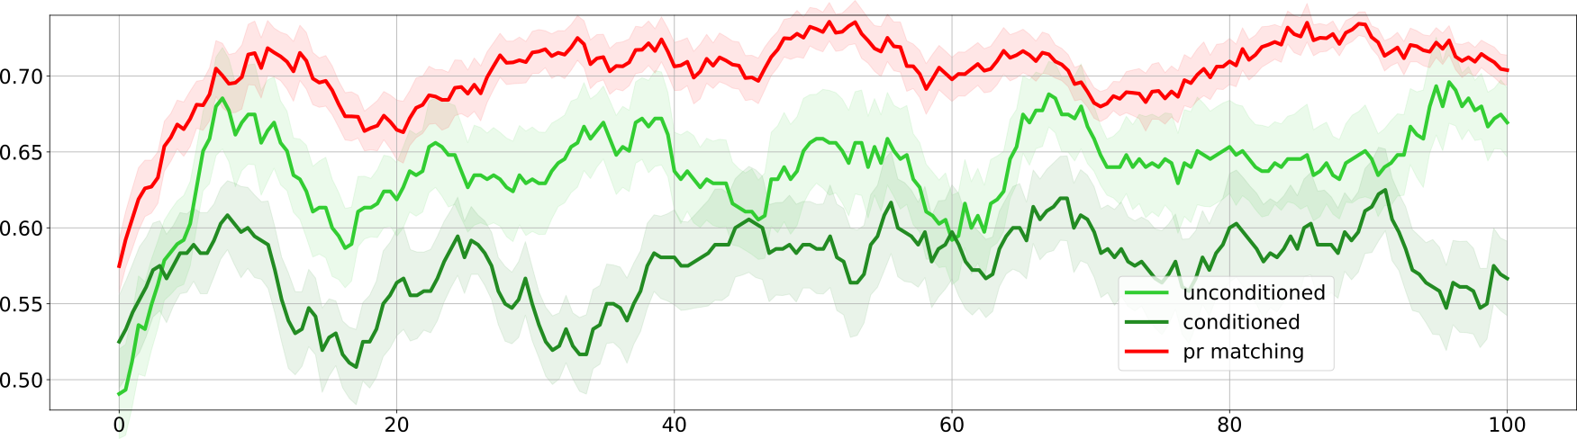
conditioned

Slide 25
low surface complexity
sample fillers:
subject = [Alice, Bob]
victim = [Bill, Claire]
skill = kung-fu
drink = coffee
dessert = cake

Slide 26
high surface complexity
sample fillers:
subject = [Alice, Bob, Claire]
victim = [Dave, Ernest, Fabio]
skill = [kung-fu, tai chi]
drink = [coffee, mocha, cappuccino]
dessert = [cake, ice-cream, cookie]

Slide 27
100 stories
probability of question 60%
different stories sequences
2 subjects 2 victims
combinatorial number of stories

Slide 28
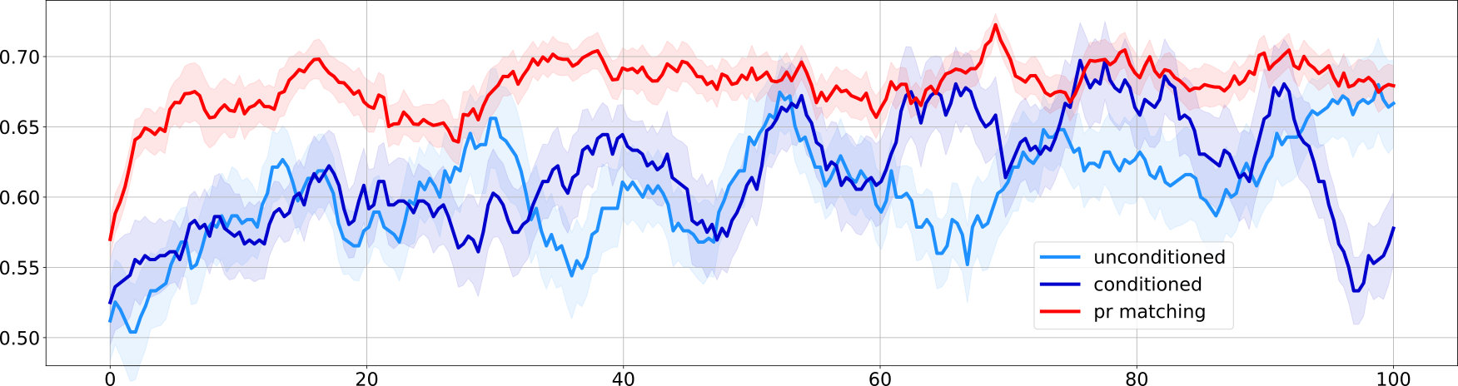
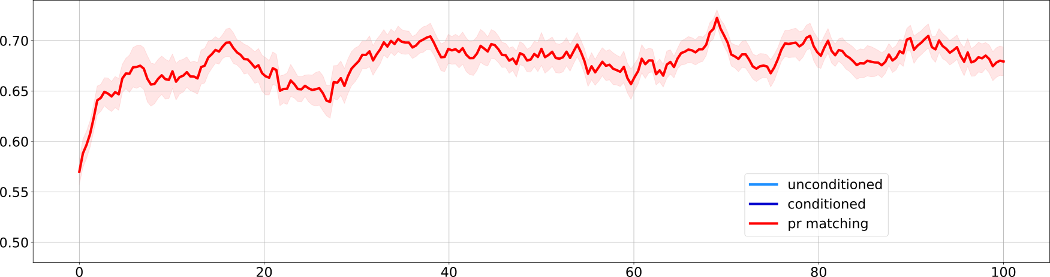
high surface complexity

Slide 29
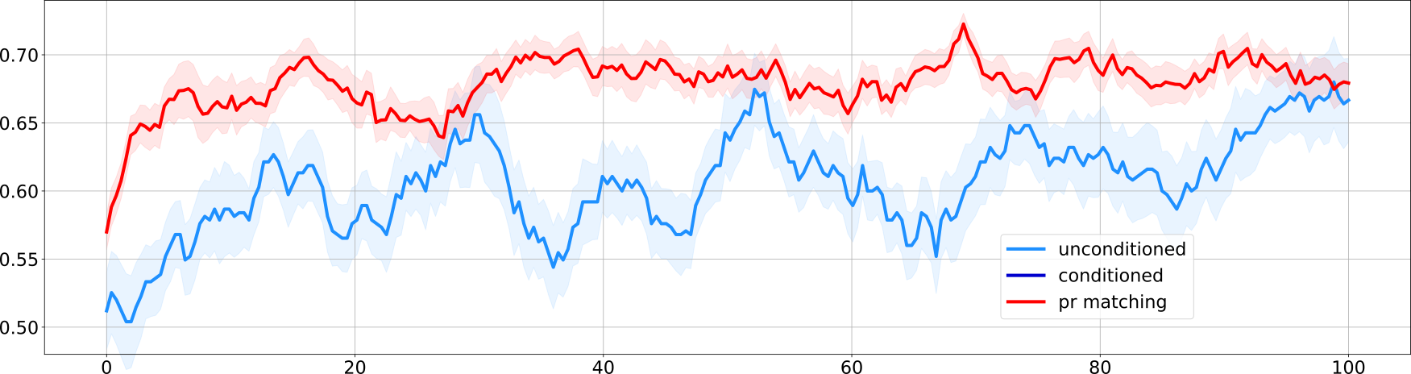
high surface complexity

Slide 30
high surface complexity

Slide 31
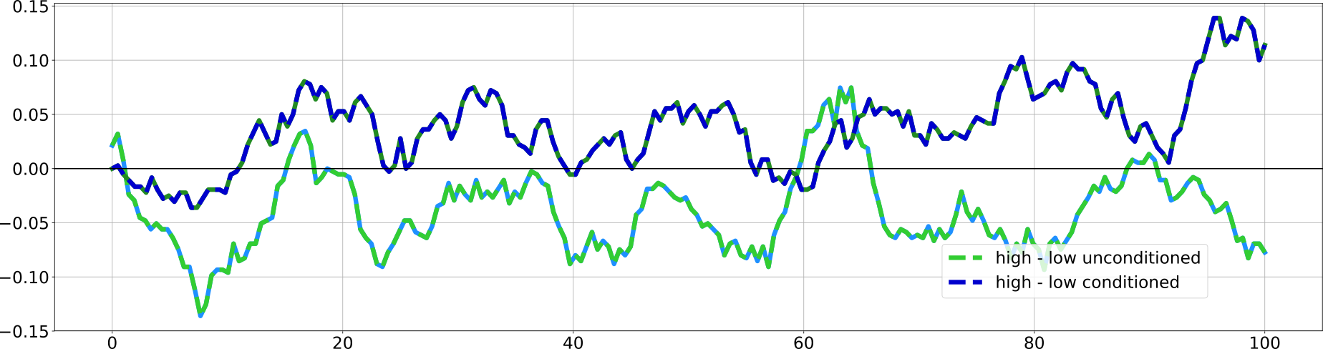
does complexity help or hinder learning?
complexity helps
complexity hinders
Notes:
note d/n survive bonf

Slide 32
interim summary
Notes:
validated new task
high surface complexity complex probability structure

Slide 33
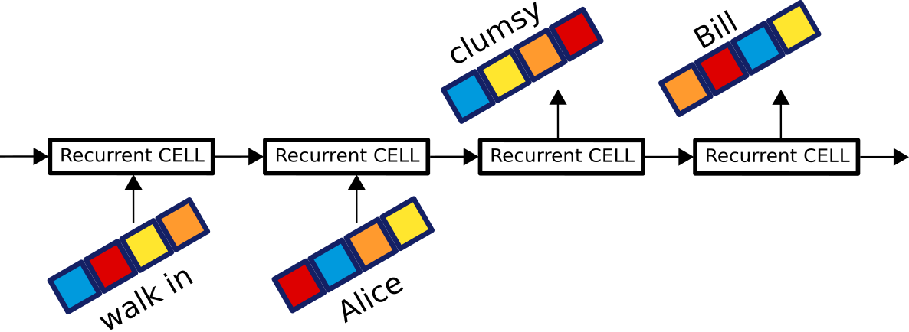
networks
seq2seq
RNN, LSTM,

Slide 34
networks
seq2seq
RNN, LSTM,
task:
given current state & filler
predict next state & filler

Slide 35
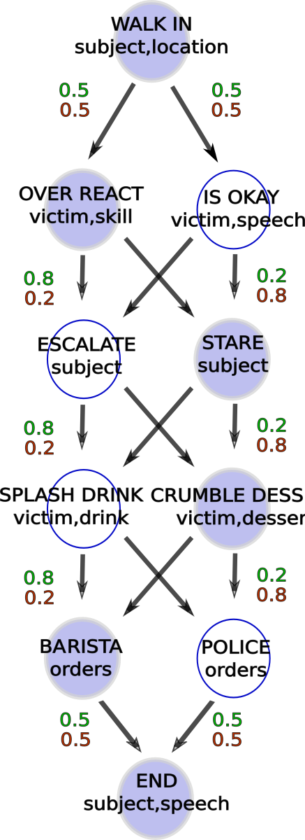
proto csw

Slide 36
proto csw
seq2seq:
sequence length 3
X

Slide 37
proto csw
seq2seq:
sequence length 3
X
Y

Slide 38
proto csw
seq2seq:
sequence length 3
two vectors: filler, state
X
Y

Slide 39
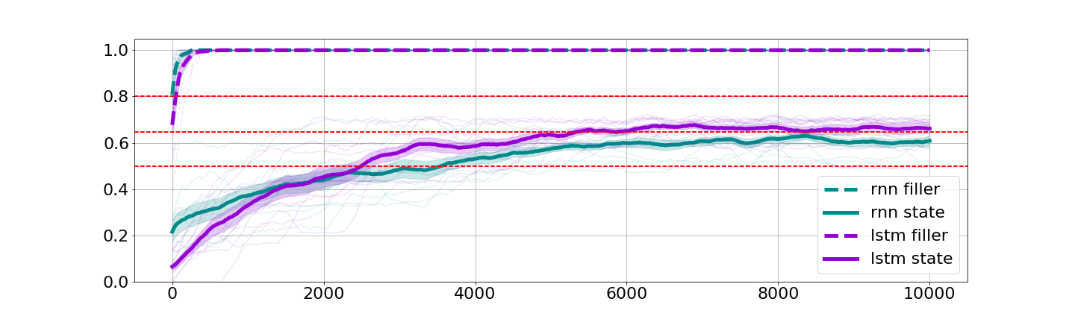
unconditioned

Slide 40
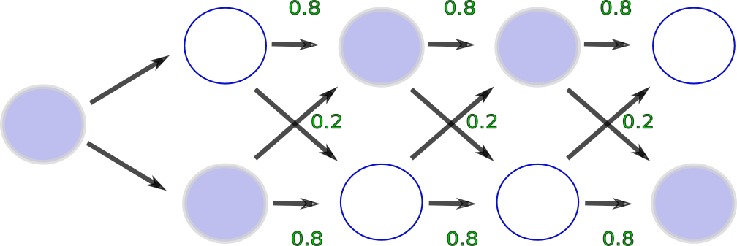

Slide 41
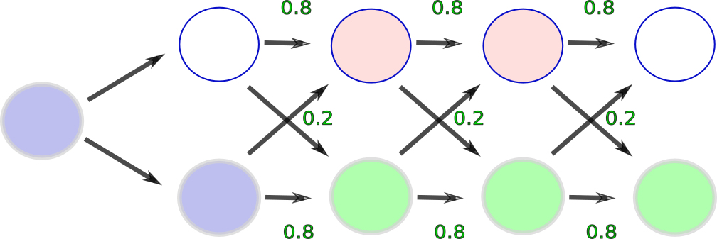
Hypothesis 1

Slide 42
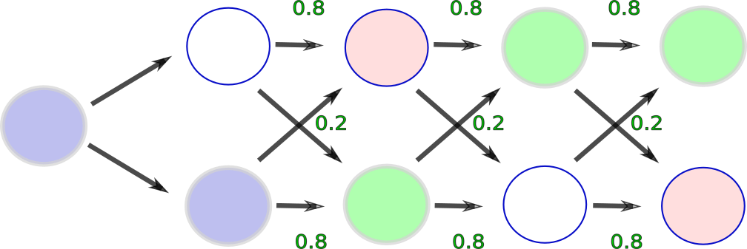
Hypothesis 1
Hypothesis 2
Notes:
note, same number of errors

Slide 43
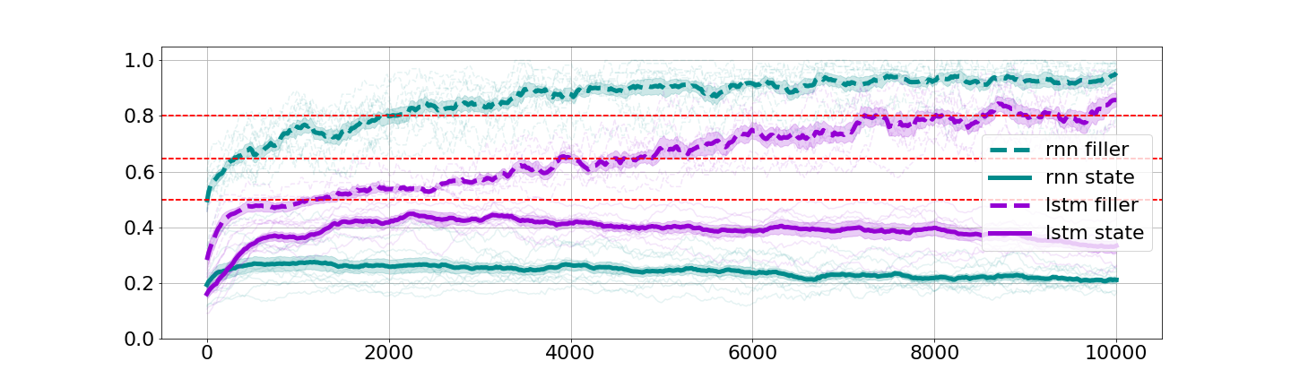
conditioned

Slide 44
summary
task for studying schemas
validated learning on human
validated learning on RNNs

Slide 45
future directions
explore different learning regimes:
blocked versus interleaved
curriculum learning
generalization

Slide 46

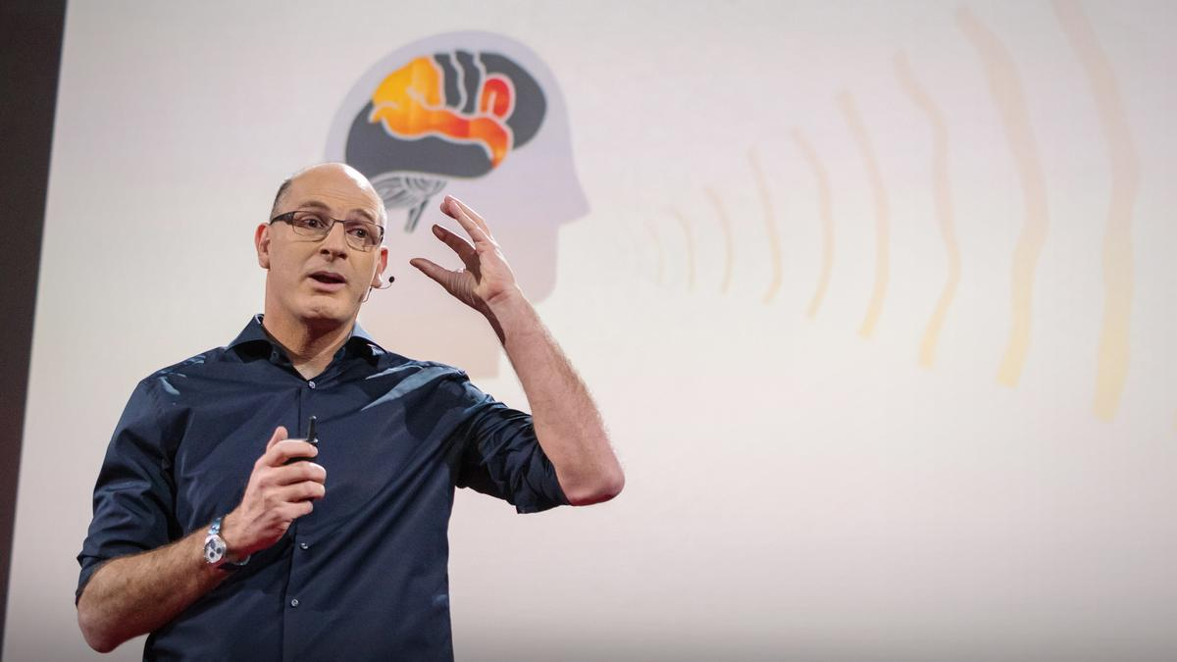
acknowledgements
Funding sources: ONR MURI N00014-17-1-2961

